Slide 1


Face Recognition Attendance System
Automating Attendance Tracking with AI
Team Members: Aditya Pandey (102303968), Yash Vardhan Singh (102303725), Mehul Kujur (102303712)
College/University Name
Date
by Aditya Pandey

Slide 2

Introduction
Problem
Manual attendance is slow and error-prone.
Solution
Automate attendance using face recognition AI.
Benefits
Improved accuracy
Increased efficiency
Real-time attendance data
Goal
Demonstrate feasibility and effectiveness of the system.

Slide 3
System Overview
Components
Workflow
Technology
Camera
Face Detection
Deep learning and computer vision techniques power the system.
Processing Unit
Recognition
Database
Attendance Marking

Slide 4
Technology Stack
Programming Language
Deep Learning Libraries
Face Recognition Tools
Python 3.9 for flexibility and support.
TensorFlow 2.0 and Keras for model building.
OpenCV and Dlib for image processing and detection.
Database
Algorithm
MySQL stores and manages student records.
VGG16 architecture for facial recognition.

Slide 5
Implementation Details
Face Detection
Feature Extraction
Recognition Method
Enrollment
Haar cascades achieve 95% detection accuracy.
CNNs extract distinctive facial features.
Capture and store unique facial embeddings securely.
Euclidean distance with 0.6 threshold for matching.

Slide 6

Training and Testing Data
1
Dataset
200+ images per student, 98% accurately labeled.
2
Data Augmentation
Rotation, zoom, and lighting variations applied.
3
Training Split
80% data for training, 20% for testing.
4
Metrics
Evaluated with accuracy, precision, recall, F1-score.

Slide 7
Results and Evaluation
Accuracy
Speed
Comparison
Visuals
System achieves 98.5% accuracy on test data.
Recognition under 0.5 seconds per face.
Outperforms manual attendance in precision and speed.
Graphs depict error rates and processing times.

Slide 8
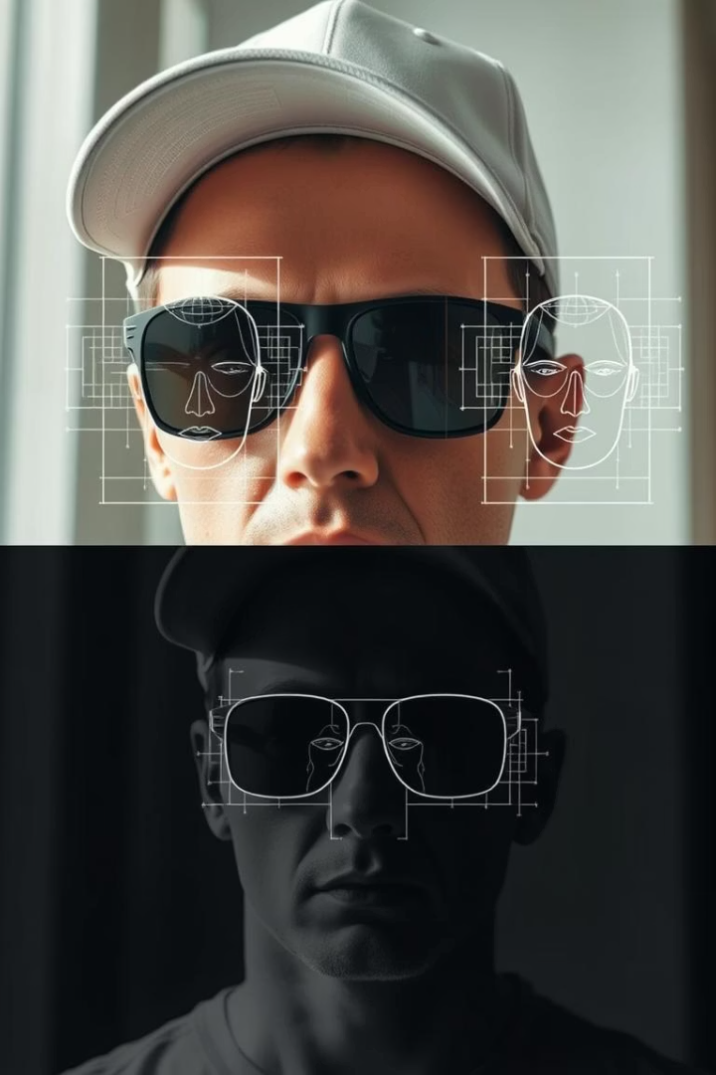
Challenges and Solutions
Lighting Conditions
Adaptive thresholding for varied illumination.
Occlusion Issues
Enhanced feature extraction handles glasses and hats.
Angle Variation
3D modeling and multi-angle capture improve recognition.
Real-Time Processing
Optimized algorithms for limited hardware capacity.

Slide 9
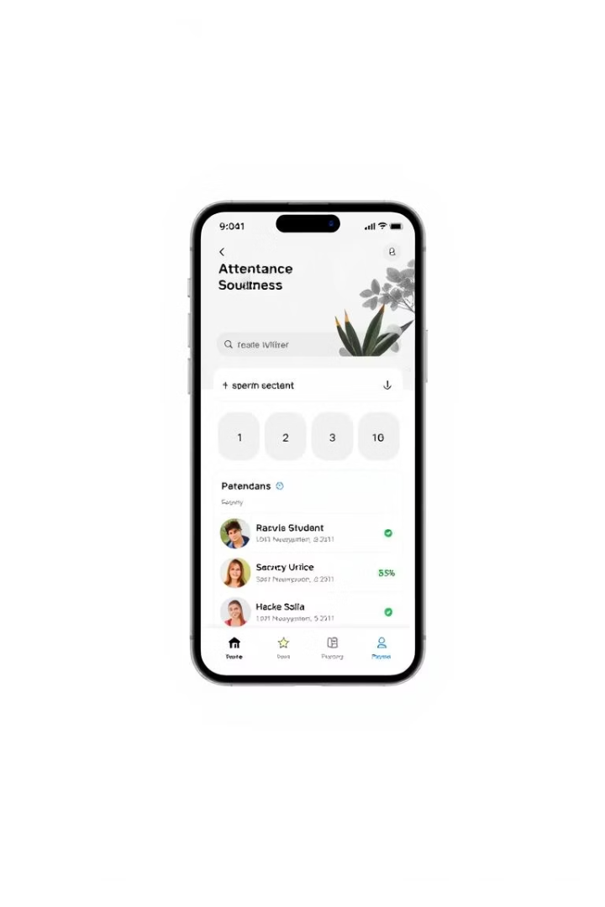




Future Scope
Mobile App
System Integration
Security
Remote attendance tracking capability.
Advanced anti-spoofing measures.
Connects with existing student systems.
Database Expansion
Supports larger student populations.

Slide 10
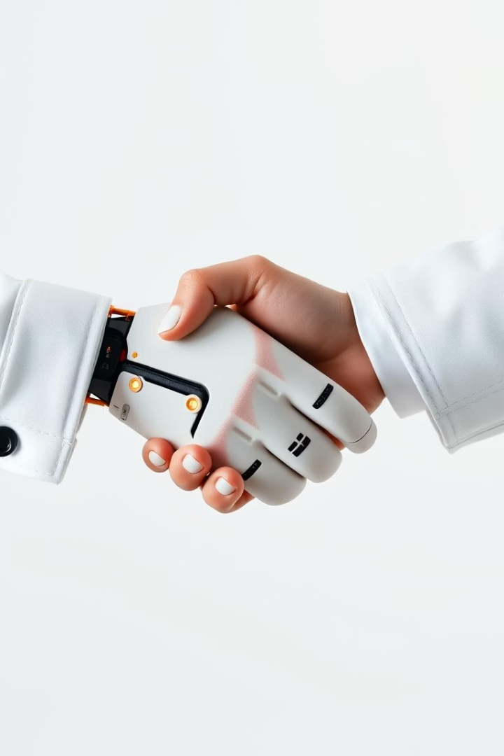




Conclusion
Automation
The system replaces manual attendance with AI.
Performance
Delivers high accuracy and efficiency.
Adoption
Ready for implementation in education.
Thank You
Open for questions and discussion.

